Slide 1

Employee Retention Analysis Domain : HR Analytics
Presented By : Yogesh Chaurasiya

Slide 2
Introduction
Employee retention is a critical facet of organizational success, impacting productivity, morale, and the bottom line. The cost of turnover is not merely financial; it extends to the disruption of workflow, loss of institutional knowledge, and the potential decline in team morale.
Recognizing this, our analysis aims to delve deep into the dynamics of employee retention, seeking insights that can guide strategic decision-making.
The purpose of this analysis is two-fold: first, to understand the existing patterns and factors influencing employee departures, and second, to propose data-driven recommendations for enhancing retention. To achieve these objectives, we leverage the power of four key software tools: Excel, Tableau, SQL, and Power BI.
Each software plays a unique role in unraveling the complexities of employee data, offering distinct perspectives that, when combined, provide a comprehensive view of the organization's retention landscape.
This presentation will guide you through our methodology, showcase the capabilities of each tool, and present actionable findings to foster a culture of improved employee retention within your organization.

Slide 3
Agenda
Objectives
Appendix
Visualizations
Recommendation
Conclusion
Data Sources
Data Methodology

Slide 4
Introduction
In this presentation, our central objective is to delve deeply into the intricate landscape of employee retention, employing a multi-faceted approach.
We aim to analyze historical data, employing a synergy of tools such as Excel, Tableau, SQL, and Power BI, to discern patterns, identify influencing factors, and extract actionable insights.
By understanding the historical context of employee retention within our organization, we seek to pave the way for informed decision-making.
The comprehensive analysis will not only spotlight successful retention strategies but also pinpoint areas necessitating improvement.
Through this exploration, we will come to know to implement strategic initiatives that enhance employee satisfaction, loyalty, and ultimately organizational success.

Slide 5
Appendix – Data Sources
Human Resources Database:
Employee demographic information (age, gender, marital status)
Employee identifiers (Employee ID)
Employment details (department, job role, years at company)
Payroll System:
Daily rate, hourly rate, and monthly income details
Overtime information
Employee Surveys:
Job involvement
Work-life balance perceptions
Performance Management System:
Performance ratings of employees
Organizational Records:
Employee count in different departments
Historical attrition data
Distance and Commuting Data:
Distance from home to the workplace for each employee

Slide 6
Appendix – Data Methodology
Data Collection:
Data Validation and Cleaning:
Conducted rigorous validation checks to ensure data accuracy, completeness, and consistency.
Addressed missing or inconsistent values, outliers, and discrepancies to enhance data reliability.
3. Data Integration:
Integrated disparate datasets from various sources for a unified and cohesive dataset.
Overcame challenges related to data format discrepancies and harmonized variables for consistency.
4. Performing various visualizations:

Slide 7
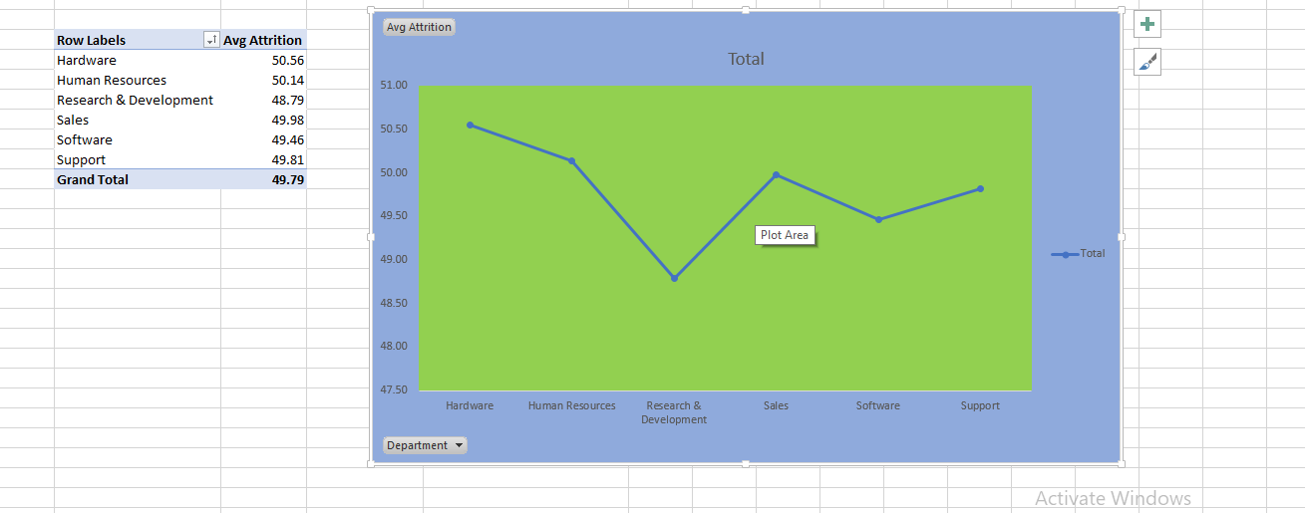
Average Attrition rate for all Departments
Here, in KPI – 1
we have shown Department wise Attrition rate in line chart.
Compare to other department Hardware dept. have highest attrition rate following by HR Dept.
&
Research & Development Dept. have lowest Attrition rate.
Attrition rate of every department doesn’t have much difference, which shows, we must have to focus on every department to retain employees.

Slide 8
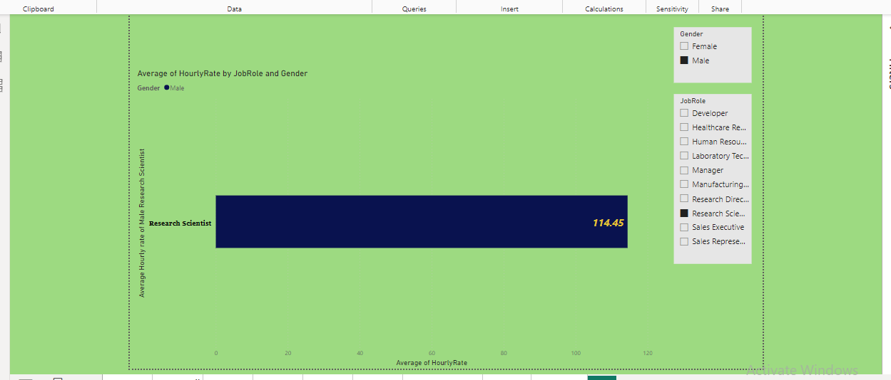
Average Hourly rate of Male Research Scientist
In KPI – 2, we gathered information of Hourly Rate of Male of Research Scientist.
Male Research Scientist hourly rate is Rs. 114.45/-
Female Research Scientist hourly rate is Rs.115/-
Department wise Male & Female hourly rate varies.

Slide 9
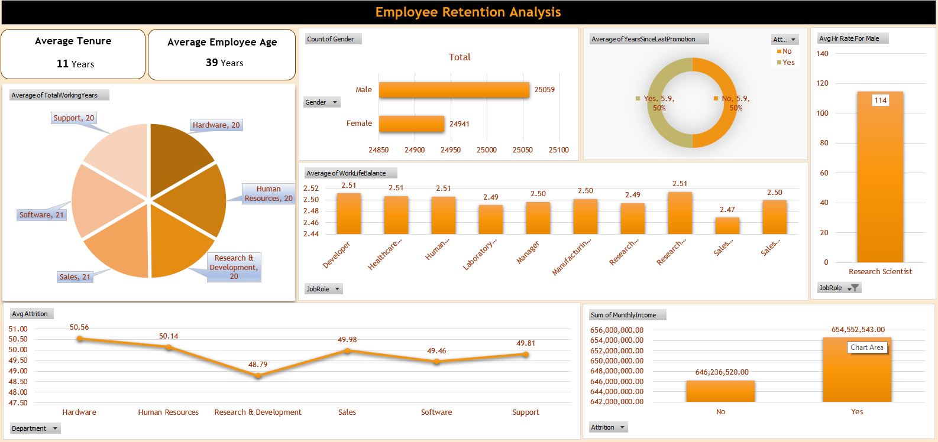
Average Total Woking Years by Department
In this, KPI - 3 denotes Average of Total Working years by Department through Pie Chart.
Sales Department employees total working years are 20.36 years & Hardware Department employees total working years are 20.68 years.
As we have seen, attrition rate of Hardware Dept. is high & total working years are low compare to other department.
Sales means backbone of the company, It shows we need to focus more on Sales Dept. employees for retention & need to understand mentality of the employees.

Slide 10
Attrition Rate Vs Monthly Income Stats.
KPI -4 shows
Attriton Rate Vs Monthly Income Stats.
Attrition Rate (yes (left employee)) Monthly Income was Rs.65,06,03,431/- & Attrition Rate (No(current headcount)) Monthly Income is Rs. 65,01,85,632/-.
The Difference between the two is Rs. 4,17,799/-
It means company is saving Rs. 4,17,799/- monthly through current headcount.
But Productivity matters a lot, so HR need to see that part also, for the better outcome.

Slide 11
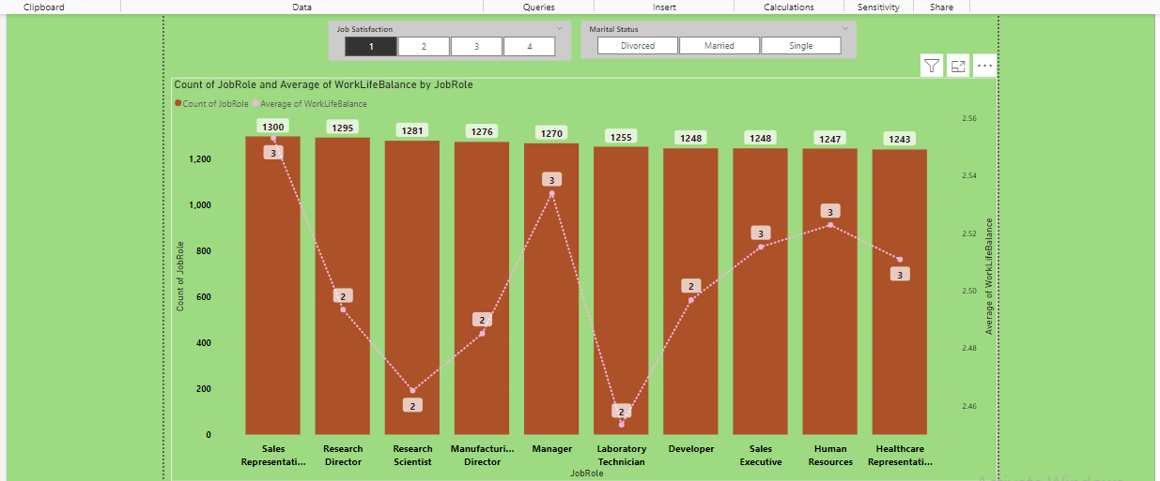
Job Role Vs Work Life Balance
KPI – 5 shows Job Role Vs Work Life Balance,
It explains, 1 to 4 rating wise employees work life balance,
As we can see, Laboratory Technician(2) & Research Scientist(2) employees have low rating.
&
Sales Representative employees have high rating (3) in work life balance.
Focus areas to improve in work life balance are Research Scientist & Lab Technician.
Need to improve healthy environment, job training, employees morale.
To improve overall work life balance of every department employees.

Slide 12
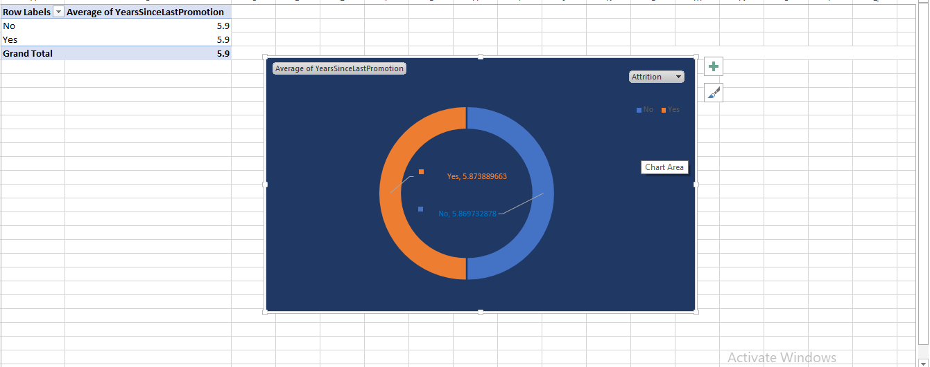
Attrition Rate Vs Year Since Last Promotion Relation
Here, KPI – 6 denotes, Attrition Rate Vs Year since Last Promotion
Attrition Rate(yes (left employees)) year since last promotion are 5.87yrs
&
Attrition Rate (No (current headcount)) year since last promotion are 5.86yrs.
There is no much difference in both.
Need to have yearly appraisals, reviews of work it will increase employees morale, productivity, focus & dedication.

Slide 13
HR Analytics : Employee Retention Dashboard

Slide 14
Recommendation
Based on our comprehensive analysis of employee data, we propose targeted strategies to address attrition and enhance organizational well-being.
Prioritize initiatives to improve work-life balance, implement personalized professional development plans, and conduct regular employee engagement surveys.
Consider flexible scheduling options, provide competitive salary adjustments, and create mentorship programs to bolster job satisfaction.
Foster a culture of open communication and transparent leadership.
Continuous monitoring of employee sentiments, paired with strategic interventions, will not only reduce attrition but also contribute to a more resilient and thriving workplace.
Implementing these recommendations will enhance employee retention, satisfaction, and overall organizational success.

Slide 15
Conclusion
In conclusion, our in-depth analysis of the employee data has unveiled valuable insights crucial for shaping the future of our organization.
The identified patterns and correlations provide a roadmap for targeted interventions to mitigate attrition and enhance overall employee satisfaction.
By focusing on initiatives such as improving work-life balance, personalized development plans, and fostering transparent communication, we can create a workplace that not only retains talent but also cultivates a culture of engagement and growth.
As we embark on implementing these recommendations, we anticipate a positive impact on employee well-being, organizational resilience, and long-term success.
This data-driven approach reinforces our commitment to a dynamic and thriving workplace.

Slide 16

We Assure That Our Observational Points Will Help To Resolve Companies Attrition Issues.
Thank You.

